Slide 1
Ethical Hacking Internship
Task - 2

Slide 2
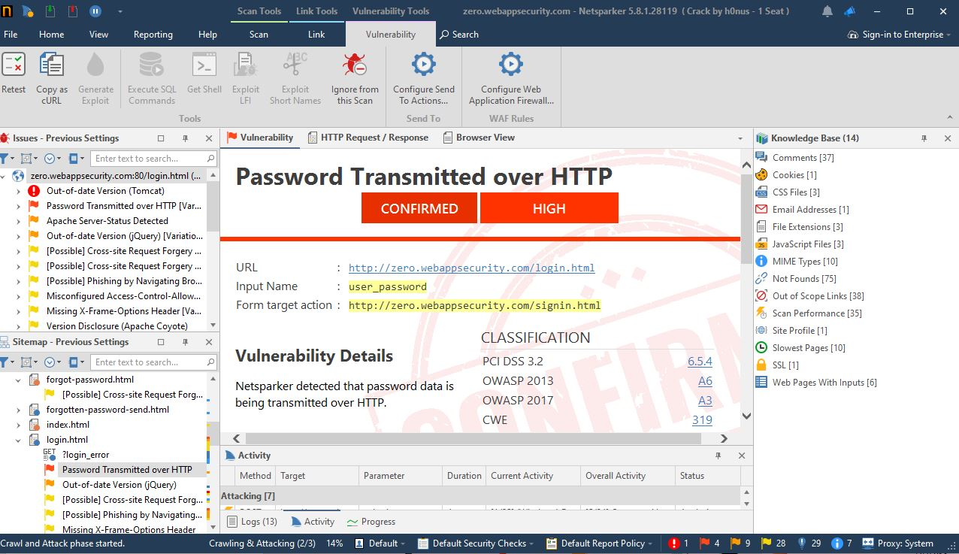

Slide 3
VULNERBILITY
Here it shows that it has been detected that passwords that have been saved are sent over HTTP rather than HTTPS whereas HTTPS is a more secure method.

Slide 4
THREAT
since it is HTTPS, all the user data that is the password are sent over this protocol, since it in not a secure protocol anyone can hack and penetrate into the network and steal all the credentials which can be used to exploit the user and his data

Slide 5
SECURITY MEASURES
All the data (i.e. user credentials , username and passwords)must all be served over an HTTPS network protocol,it is a secure method of network and all data transferred over this network is safe from any attacker or threats.

Slide 6
THREAT FOUND :URL :http://zero.webappsecurity.com/login.html
Input Name :user_password
Form target action :http://zero.webappsecurity.com/signin.html
HOW IT WAS DETECTED :It was detected by an well known automatic vulnerability application known as INVICTI(NETSPARKER).

